Slide 1
主管超連鎖™店主計劃與分享
Master UFO Program and Sharing
Nora Siu
高級顧問經理級
Director
四個佣金週期共賺取HK$138,000
HK$138,000 in 4 Commission weeks
本簡報中提到的收入等級純屬舉例說明，無意代表美安香港超連鎖™店主的一般收入，也無意表示任何超連鎖™店主皆可賺取同等收入。美安香港超連鎖™店主的成功與否，取決於其在發展事業時的努力、才能與投入程度。
The income levels mentioned in the following presentation are for illustration purposes only. They are not intended to represent the income of a typical Market Hong Kong UnFranchise ™Owner, nor are they intended to represent that any given Independent UnFranchise ™ Owner will earn income in that amount. The success of any Market Hong Kong Independent UnFranchise ™ Owner will depend upon the amount of hard work, talent, and dedication which he or she devotes to building his or her Market Hong Kong Business.

Slide 2
FOLLOW ME ON SOCIAL MEDIA
@nsiu123
facebook.com/Nora SIU

Slide 3
Goal
Goal
Strategic Goal
Goal

Slide 4
Master UFO Action Plan to Achieve Your Dream

Slide 5
MUFO Qualification = Target Setting
Complete Shopping Annuity™ Assessment
Must have a subscription for the UnFranchise Management System (UFMS)
Purchase a total of 1,500 BV+IBV of product for the respective quarter
Generate HK$11,500 worth of Partner Store purchases between you and your customers
Enter the names and the UnFranchise Identification Numbers of the two qualified and active UnFranchise Owners that you personally sponsored for the respective calendar quarter.
Convert Spending
Maintain Operation
Retail (Personal consumption + Customer orders)
Convert Spending (Personal consumption + Customer orders)
Sponsor (Team building)

Slide 6
MUFO Qualification = Target Setting
6. a. Attended or conducted one New UnFranchise Owner Training (NUOT).
b. Attended or conducted one Basic 5 Training (B5).
c. Attended or conduct one Executive Coordinator Certification Training (ECCT).
d. Purchase a minimum of three tickets to Annual Convention or Leadership School.
7. Complete a Basic 5 Diagnostic Test, in which you score greater than or equal to 50 percent AND/OR earn a minimum of HK$6900 in commissions for the respective quarter (BV and/or IBV).
GMTSS
Self-enhancement
Practice what you preach
Build the team
Self-assessment

Slide 7
How to implement
MUFO 12 weeks training program?

Slide 8
The roadmap to success
Getting Started Guide>MUFO>SAMM

Slide 9
MUFO Milestones Planning
1st Month
2nd Month
3rd Month
1st Week
2nd Week
3rd Week
4th Week
5th Week
6th Week
7th Week
8th Week
9th Week
10th Week
11th Week
12th Week

Slide 10
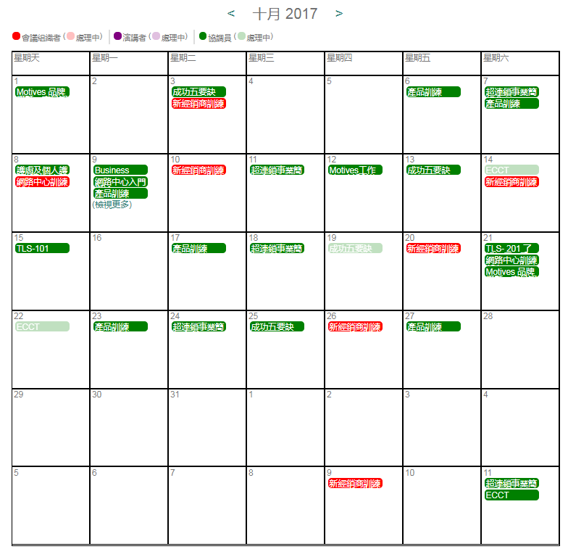
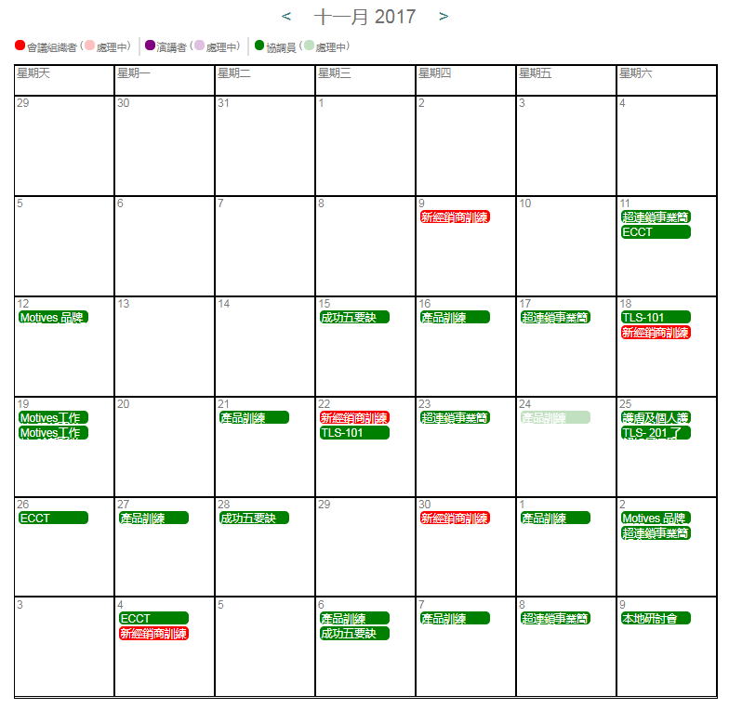
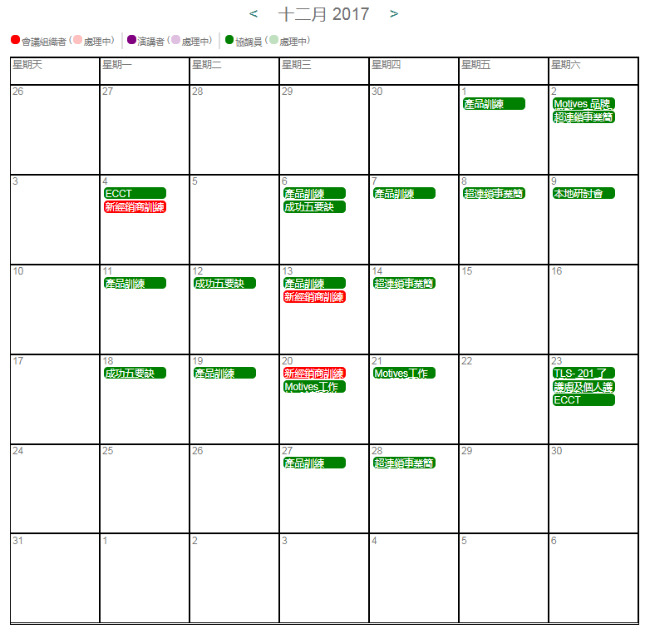
Target : Attitude and Knowledge
Attend GMTSS trainings
1st Month
NUOT
2nd Month
B5
3rd Month
ECCT

Slide 11
Target: 1500BV+IBV
(Personal consumption + Customer orders)
1st Month
500BV
2nd Month
500BV
3rd Month
500BV
1st Week
125BV
2nd Week
125BV
3rd Week
125BV
4th Week
125BV
5th Week
125BV
6th Week
125BV
7th Week
125BV
8th Week
125BV
9th Week
125BV
10th Week
125BV
11th Week
125BV
12th Week
125BV

Slide 12
Target : HK$11,500
partner stores purchases
1st Month
$4000
2nd Month
$4000
3rd Month
$4000
1st Week
$1000
2nd Week
$1000
3rd Week
$1000
4th Week
$1000
5th Week
$1000
6th Week
$1000
7th Week
$1000
8th Week
$1000
9th Week
$1000
10th Week
$1000
11th Week
$1000
12th Week
$1000

Slide 13
Target: Sponsor 2 UFOs
1st Month
2nd Month
3rd Month
1st Week
2nd Week
3rd Week
4th Week
5th Week
6th Week
7th Week
8th Week
9th Week
10th Week
11th Week
12th Week

Slide 14
Target: Sponsor 2 UFOs
128ppl (Around 10-11 people/week, 1.7 people/day)
Make Appointment, show plan, shop.com
32 people (Around 2.6 people per week)
8 people (Around 0.66 people per week)
Successful Sponsorship
2 people
Develop a list－Chat, Approach
Attend UBP – Make sure you have tickets on hand!

Slide 16
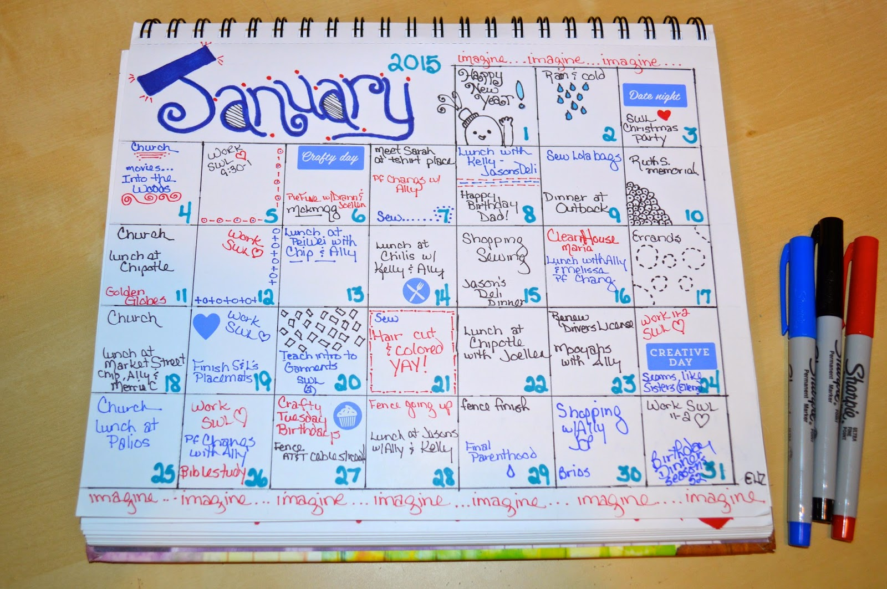
Discipline

Slide 17
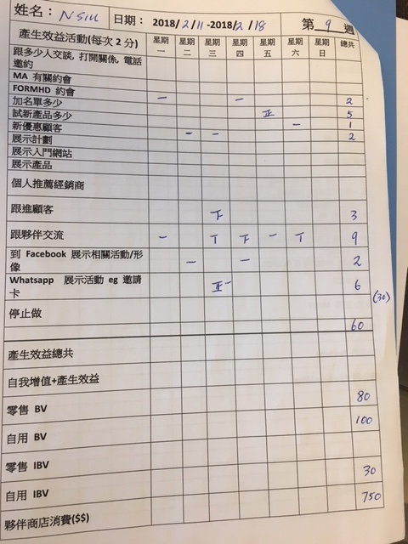
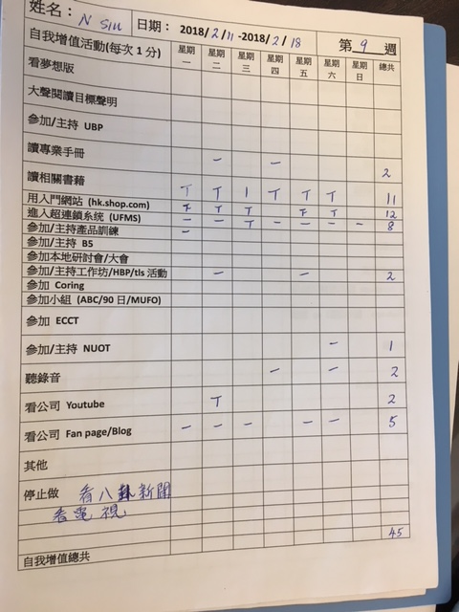
Result Producing
Self-enhancement

Slide 18
MUFO 12-week training team structure
MC
Coordinator
Coordinator
Leader
Leader
Junior
Leader
Junior
Leader
Junior Leader
Junior Leader
Junior Leader
Junior Leader
Teammate
6~8 people
Teammate
6~8 people
Teammate
6~8 people
Teammate
6~8 people
Teammate
6~8 people
Teammate
6~8 people
Teammates are welcome to invite guest to attend
the training together

